Slide 1
Introduction to Machine Learning
Rosa andrie, arie rachmad s., vipkas ah.

Slide 2
Machine learning
Subfield of Artificial Intelligence
Learn from examples and experience. Building a mathematical model of sample data to make predictions without explicitly programmed to perform the task.
Machine learning used in many complex and messy problem in the real world application, such as email filtering, computer vision, product recommendation in online stores, etc.
Focuses on making predictions using computer, learn from previous data.

Slide 3
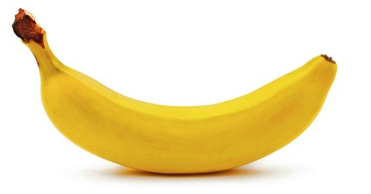

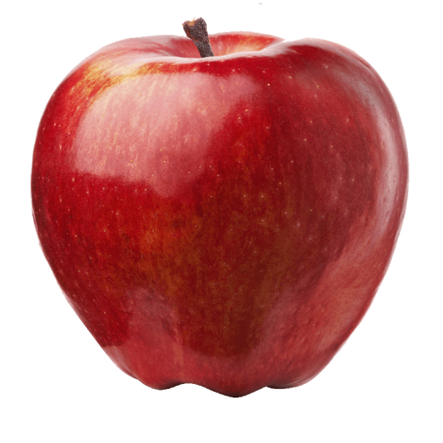
banana
Image file
Rules to predict “Banana”, such as yellow color or “long shapes”.

Slide 4
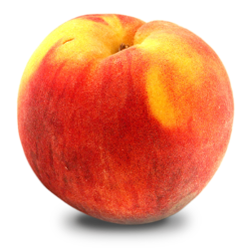
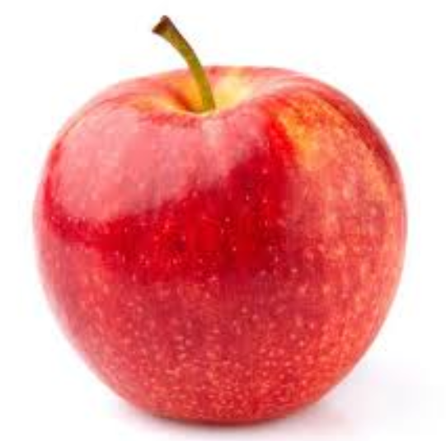
Real World problem is too complex, rules would be to much to coded, we need to train a classifier
Peach image
Apple 1 image
Apple 2 image

Slide 5
Classifier
Classifier is used to classify the data
Takes data as an input, and label / class as an output
The technique to create the classifier automatically is called Supervised Learning
Supervised Learning :
Create a Classifier by finding pattern in examples.

Slide 6



Slide 7
Supervised Learning Step
Collect Training Data
Train the classifier
Make a prediction

Slide 8
Collect Training Data
FEATURES
FEATURES
LABELS
Weight | Shape | Label
200g | Moon | Banana
180g | Moon | Banana
130g | Round | Apple
142g | Round | Apple
… | … | …
EXAMPLES
The more examples we have, the better classifier we have

Slide 9
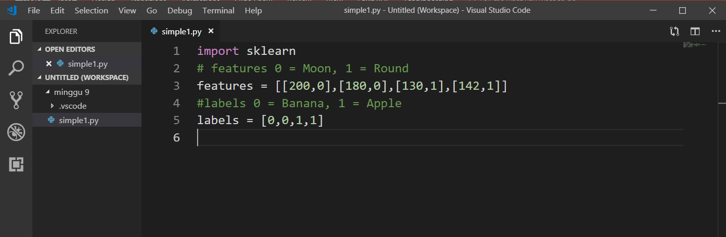
Scikit use real values features

Slide 10
Train the Classifier
Collect Training Data
Train the classifier
Make a prediction

Slide 11
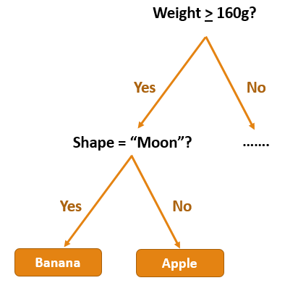
Decision Tree
Weight > 160g?
150g, round shape
Yes
No
Shape = “Moon”?
…….
Yes
No
Banana
Apple
Apple

Slide 12
Classifier will find pattern in training data. in Scikit, training algorithm is provided, and we call it “fit”
“fit” is synonym with “finding pattern in data”
Use predict object to predict the data
Collect Training Data
Train the classifier
Make a prediction

Slide 13
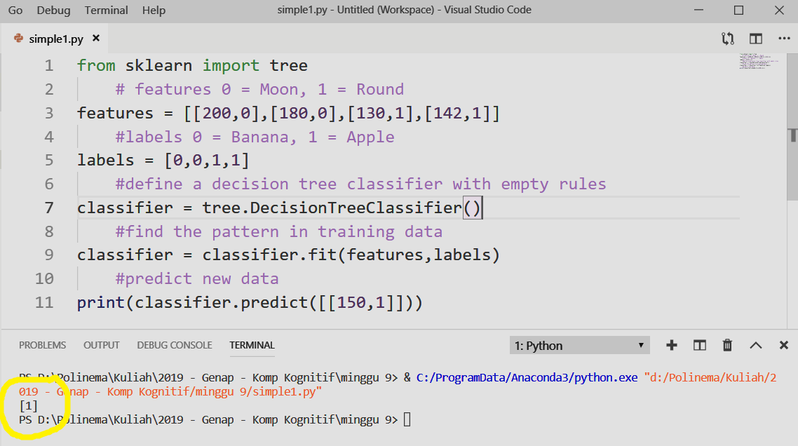

Slide 14
RAM | LCD Type | Label
2gb | TFT | LowEnd SP
3gb | IPS | LowEnd SP
12gb | Super Amoled | Flagship
8gb | Amoled | Flagship
… | … | …
Predict what type of a smartphone 6.4inch screen size with IPS screen type, snapdragon 645 1.8GHz Octa-Core processor, 4GB of RAM and 64GB ROM?

Slide 15

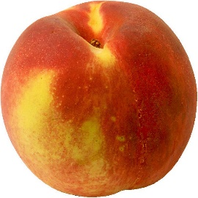
Image | Label
 | Apple
 | Apple
 | Peach
 | Peach
… | …

Slide 16
Models of Classifier
Decision Trees
Artificial Neural Network (Perceptron, Backprop, CNN)
K-Nearest Neighbors
Support Vector Machine
Bayesian Network
Genetic Algorithm

Slide 17
Decision Tree
Easy to read and understand
Easy to Implement in code
One of few model that can be visualized

Slide 18
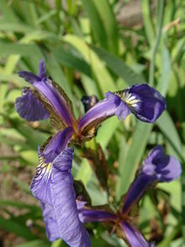
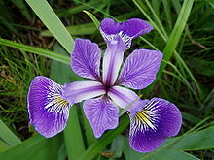
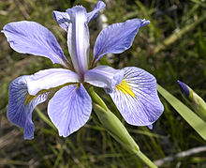
Iris Flower Dataset
Versicolor
Virginica
Setosa

Slide 19
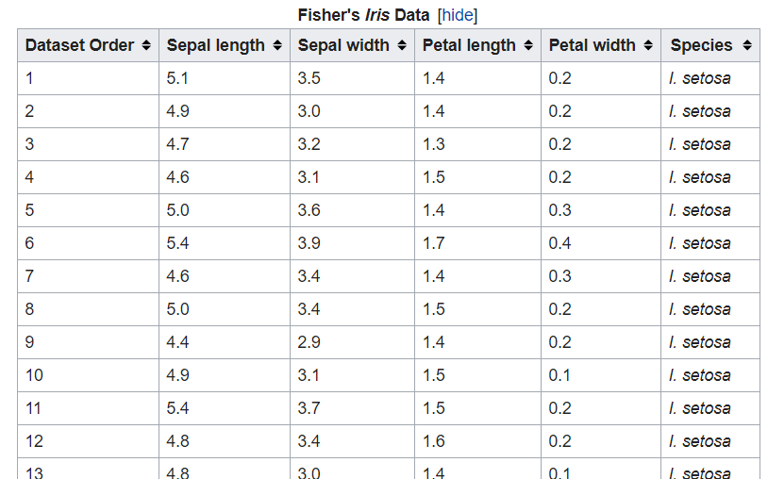

Slide 20
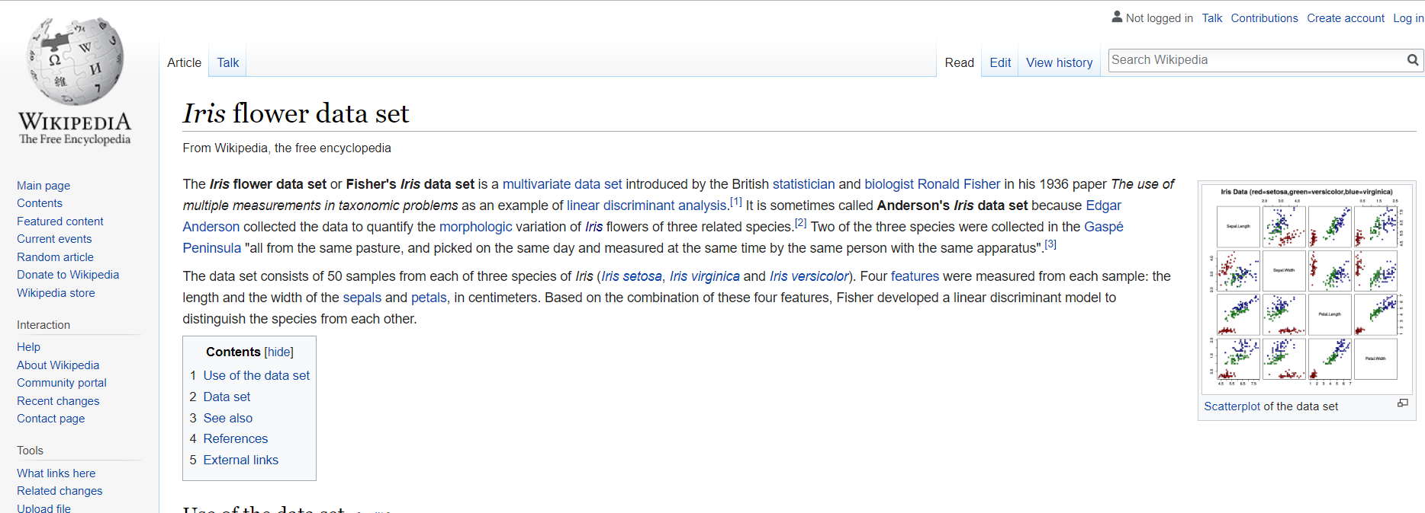

Slide 21
Steps
1. Import Iris Flower Dataset (scikit provide Iris Dataset)
2. Train a Classifier
3. Predict new flower
4. Visualize the tree

Slide 22
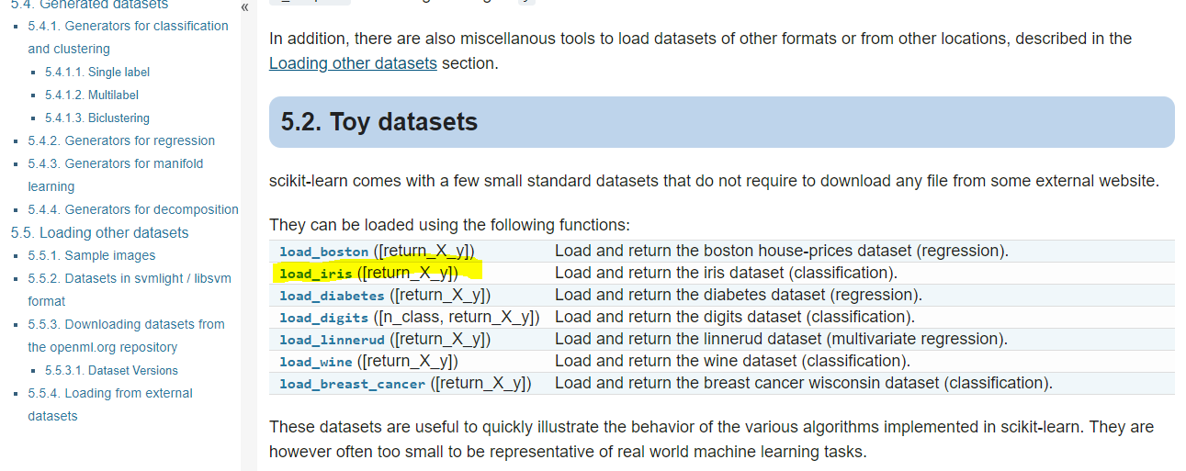

Slide 23
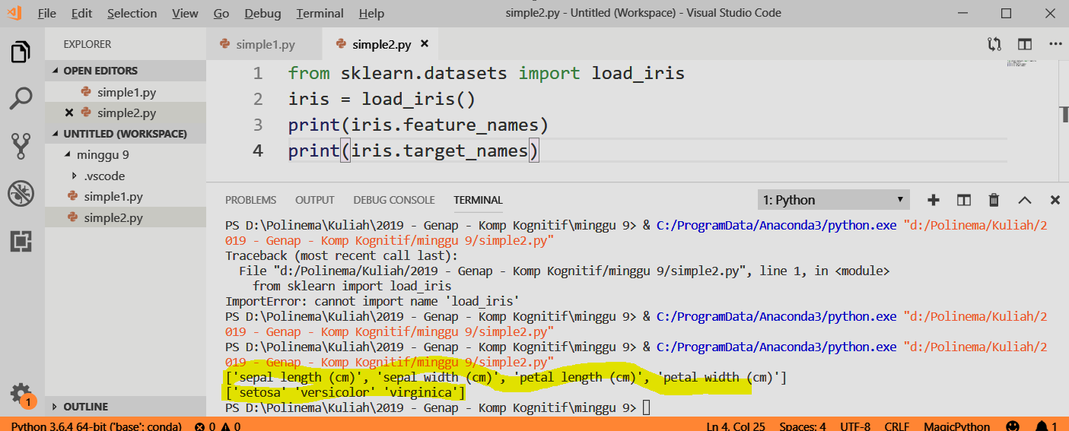

Slide 24
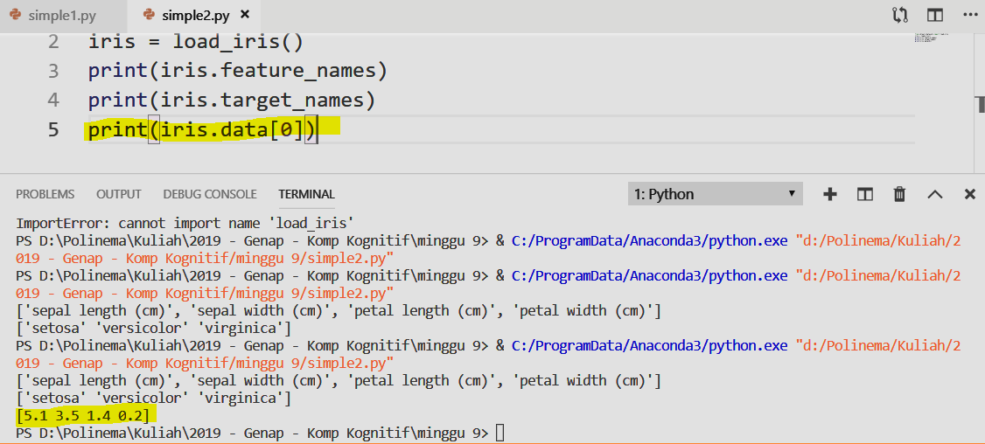

Slide 25
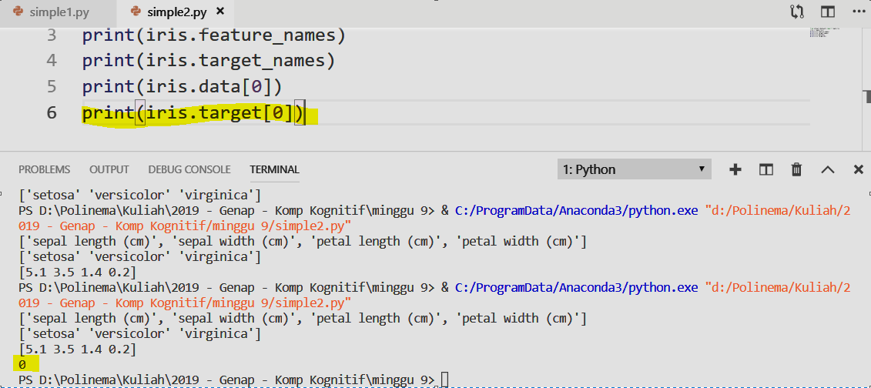
Iris Target: 0 = Setosa, 1 = Versicolor, 2 = Virginica

Slide 26
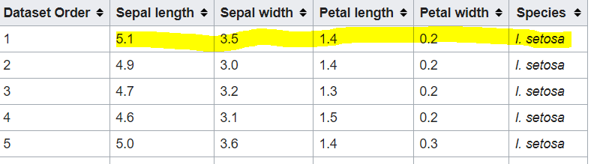

Slide 27
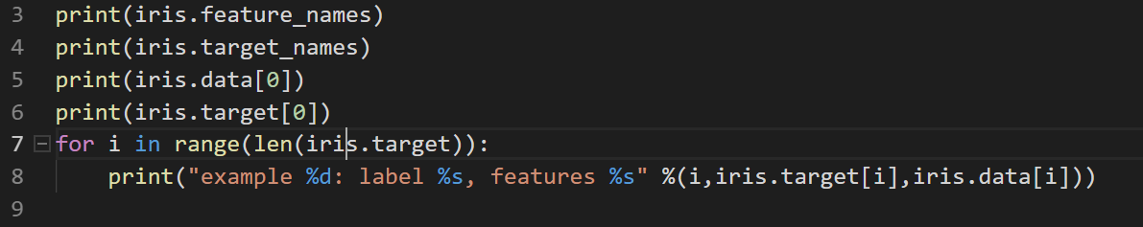

Slide 28
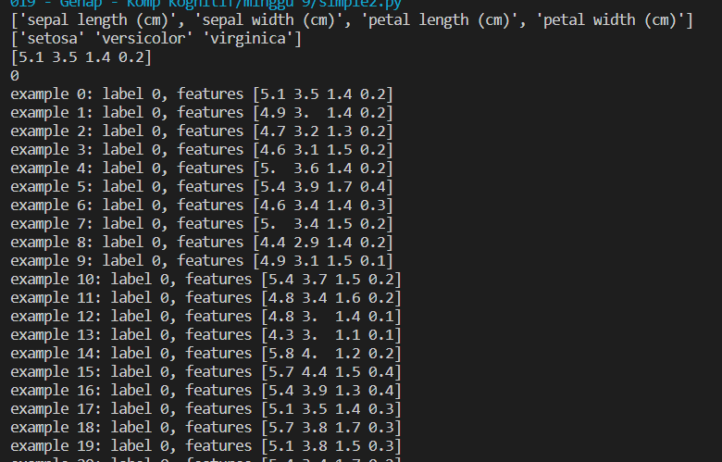

Slide 29
Steps
1. Import Iris Flower Dataset (scikit provide Iris Dataset)
2. Train a Classifier
3. Predict new flower
4. Visualize the tree

Slide 30
Split the dataset
Training Data
Testing Data
Testing Data is not part of trained data.

Slide 31
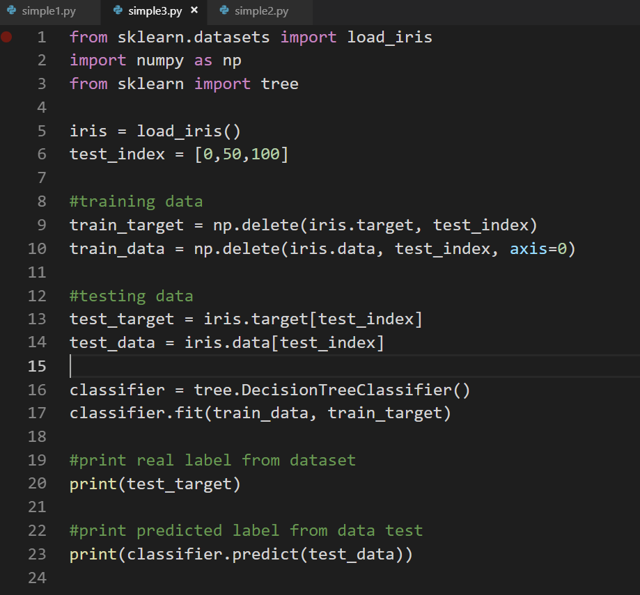

Slide 32
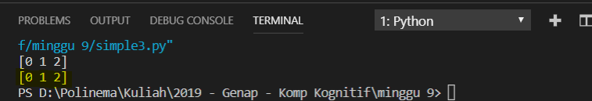

Slide 33
Steps
1. Import Iris Flower Dataset (scikit provide Iris Dataset)
2. Train a Classifier
3. Predict new flower
4. Visualize the tree

Slide 34
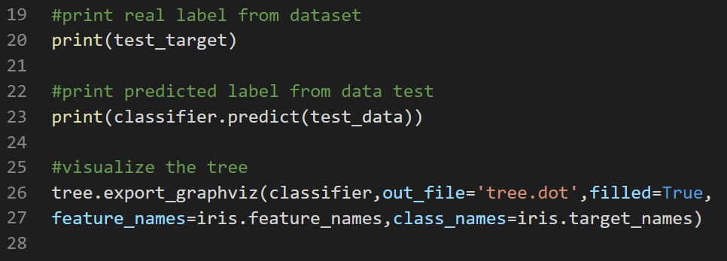

Slide 35
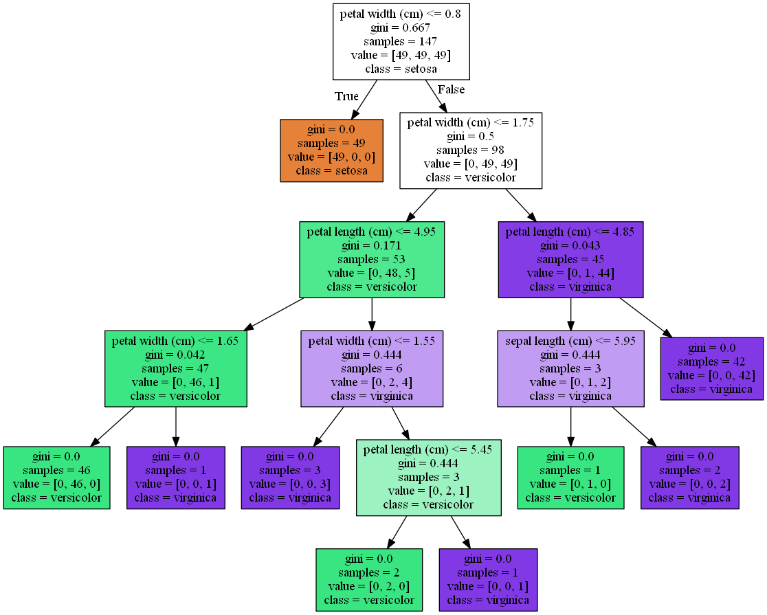

Slide 36
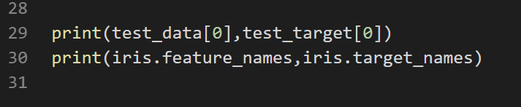
Using the tree, analyze for each testing data.

Slide 37
Conclusion
Good features usage is the first most important things to do before classify the data.

Slide 38
K – Nearest Neighbor (KNN)

Slide 39
Notes:
Suppose that you have two class (class1:orange triangle and class2:yellow circle), if you have new data (rectangle) to classify between those two class, which class will it become
Since the orange line is the closest, rectangle will become class1
<number>

Slide 40
Notes:
Suppose that you have two class (class1:orange triangle and class2:yellow circle), if you have new data (rectangle) to classify between those two class, which class will it become
Since the orange line is the closest, rectangle will become class1, using 3neighbors, rectangle will become class2. KNN have K parameter to determine how many neighbor use to classify the data.
<number>

Slide 41
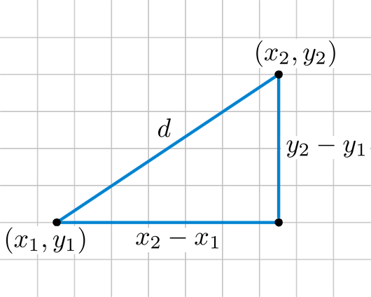
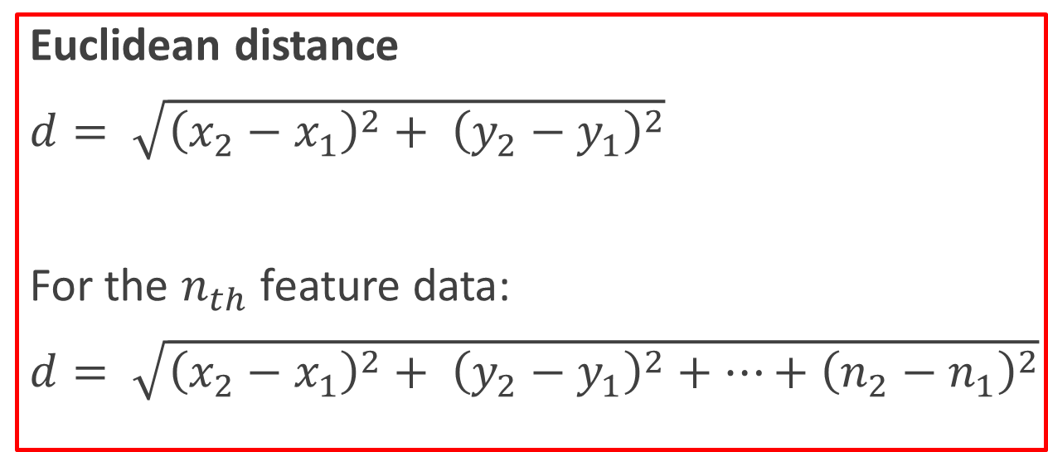
Measuring the distance

Slide 42
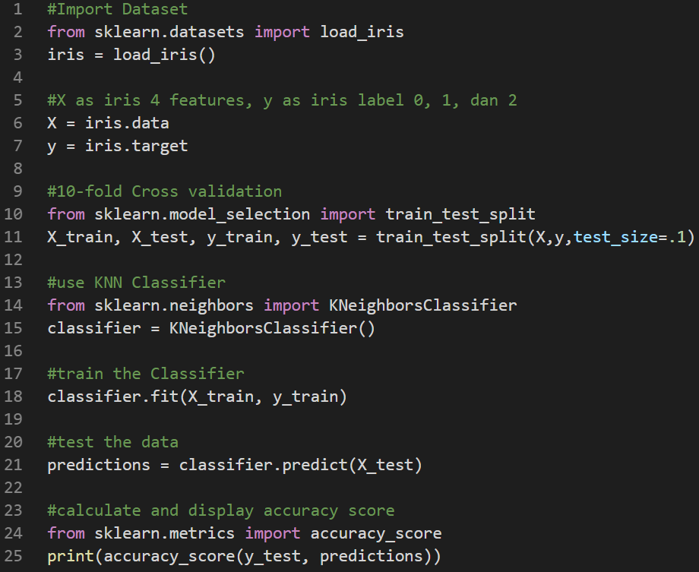

Slide 43
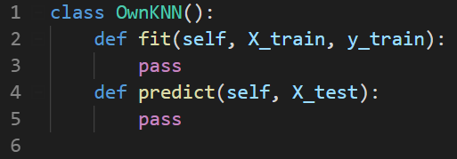
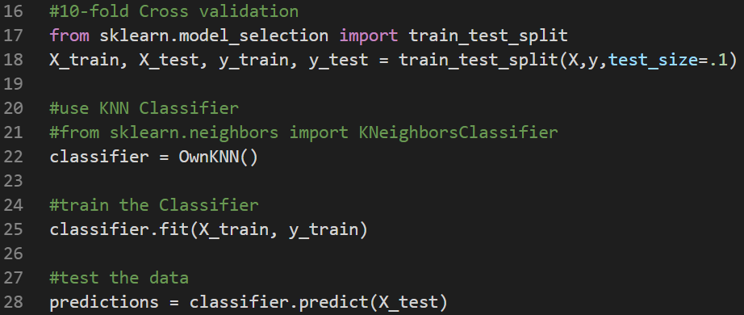

Slide 44
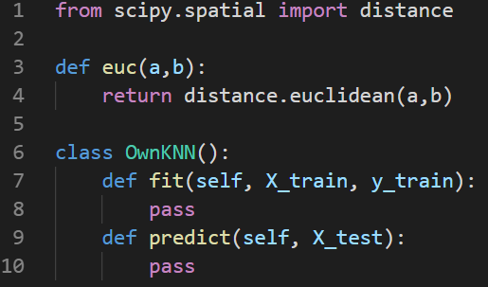
Defining Euclidean Distance

Slide 45
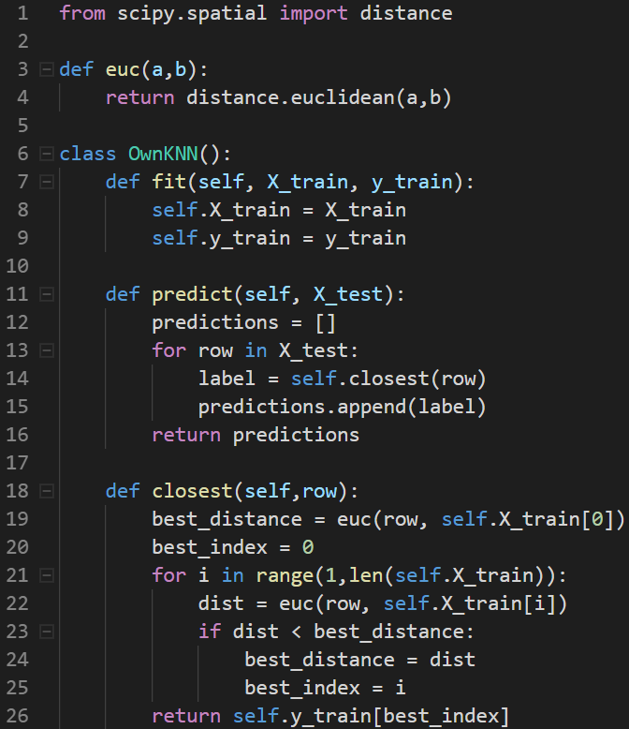

Slide 46
THANK YOU

